Slide 2
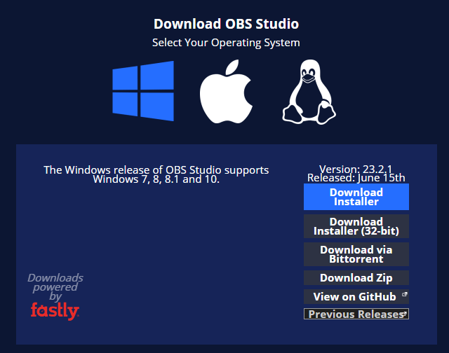
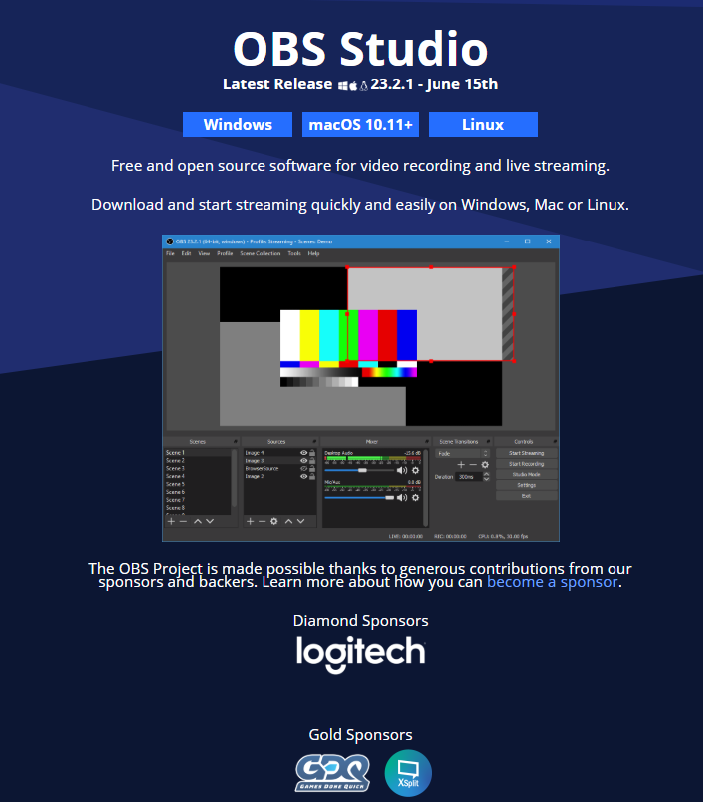

OBS Open Broadcaster Software
Logo
Download page
https://obsproject.com/download
Homepage

Slide 3
Why OBS
Free software.
Support Linux, Mac, and Windows.
Royalty free.
Open source (https://github.com/obsproject/obs-studio)
250+ contributors
Malicious free (open source codes)
Direct connection between OBS software and broadcaster server.
Mature software (Release 23.x.x @ day the of present)
Easy to use.

Slide 4
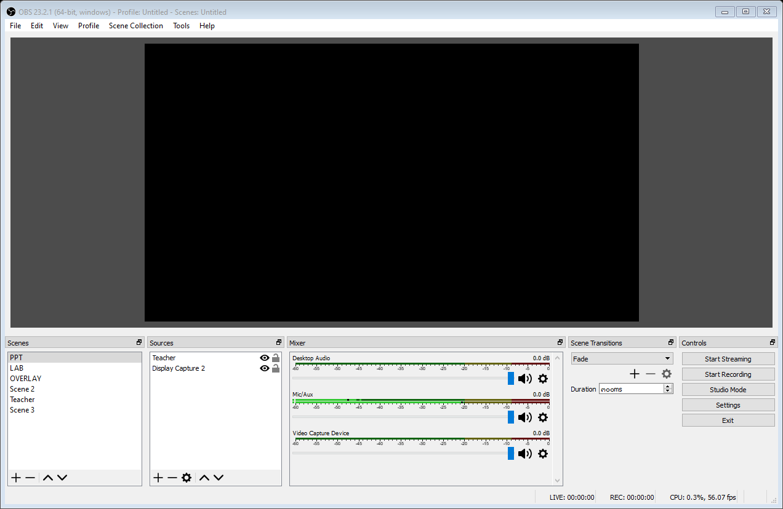
Open Broadcaster Software interface (Classic mode)
1
Menu bar
Monitor
Scenes
Sources
Mixer
Scene Transitions
Controls
2
3
4
5
7
6

Slide 5
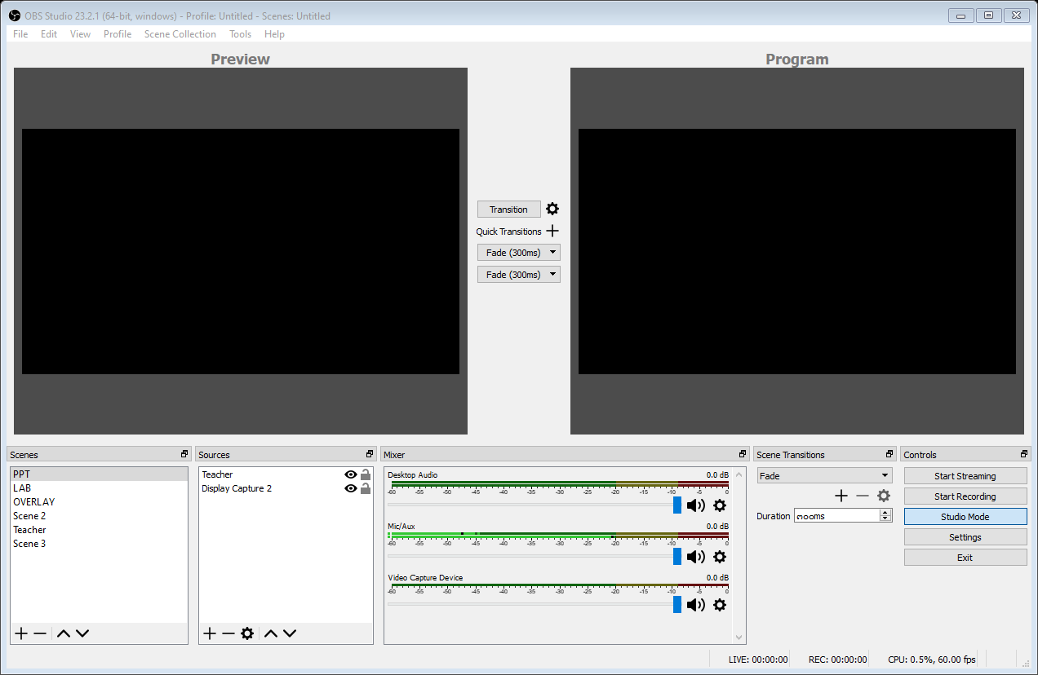
Studio mode
1
Menu bar
Preview monitor
Transition
Program monitor
Scenes
Sources
Mixer
Scene Transitions
Controls
2
3
4
8
9
Studio mode
5
6
7

Slide 6
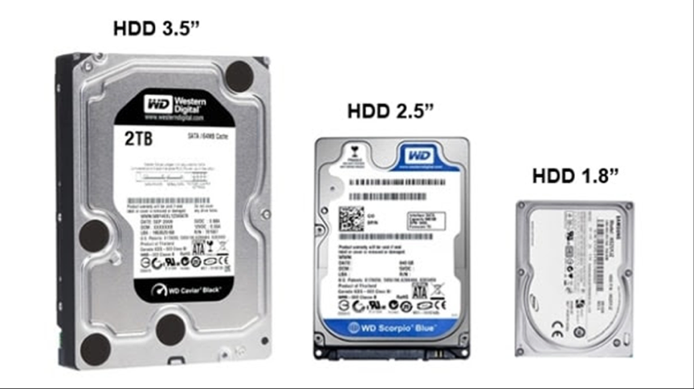
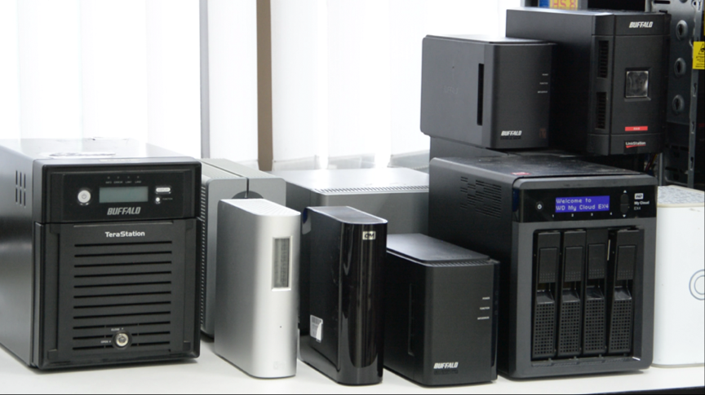




OBS Concepts
Source 1
Scene 1
Scenes
Transition
Source n
Recording
Source 1
Broadcasting
Scene m
Source n
Controls
…

Slide 7

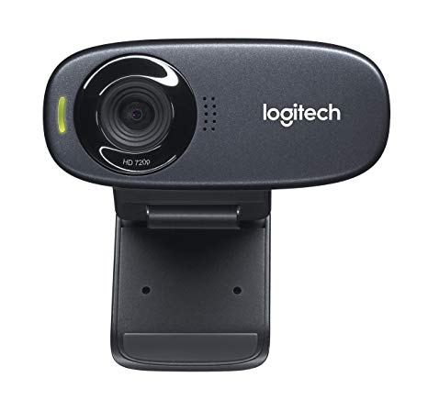
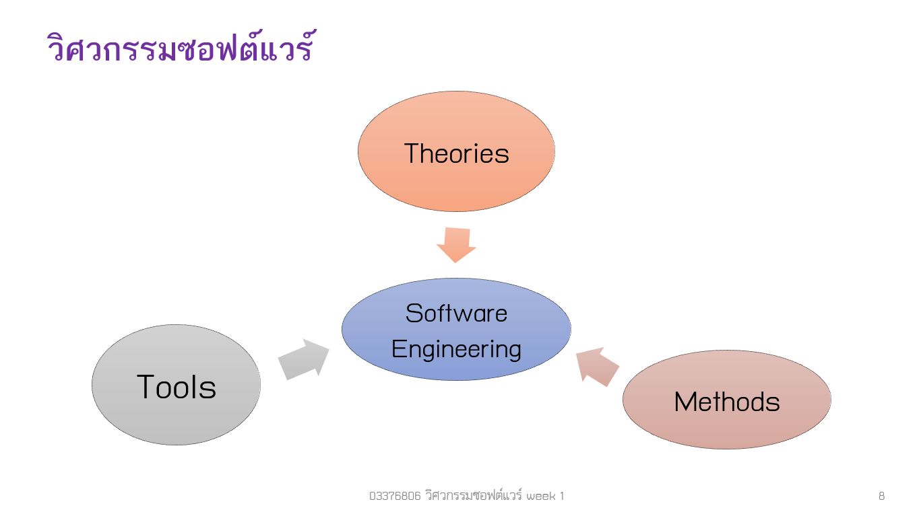


Source/Scene concept
Source 2
Source 1
Software Engineering
Software Engineering
Source 3

Slide 8
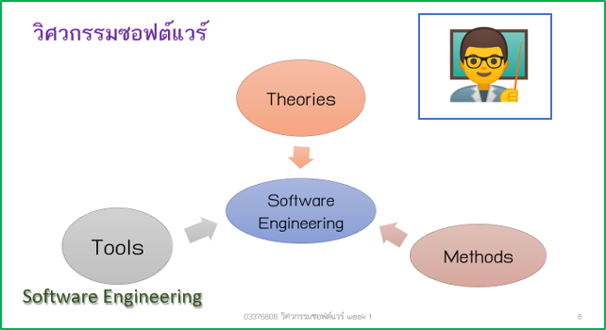
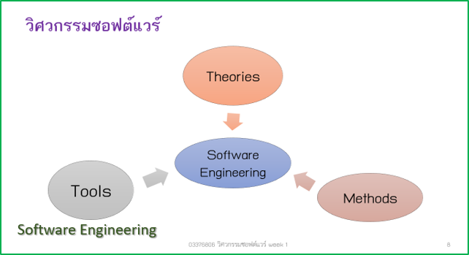

Scene/Transition concept
Scene 1
Source 1
Source 2
Source 3
Software Engineering
Scene 1
Scene 2
Scene 2
Source 1
Source 3
Software Engineering

Slide 9
OBS Source list
Audio Input Capture
Audio Output Capture
Blackmagic Device
BrowserSource
Color Source
Display Capture
Game Capture
Image
Image Slide Show
Intel® RealSense™ 3D Camera GreenScreen
Media Source
Scene
Text (GDI+)
VLC Video Source
Video Capture Device
Window Capture
Deprecated Sources

